Slide 1
Intro to outcomes
Julie Carroll
Outcomes Lead, General Assembly

Slide 2
TodaY’s Agenda
INTRO TO OUTCOMES WORKSHOP
Introductions
What is Outcomes? What isn’t it?
Providence specifics
Structure of Outcomes programming
In-course support and post-course support
Setting expectations for working together
Notes:
+ 13 other producers in other markets around the world

Slide 3
INtroductions
GA OUTCOMES

Slide 4
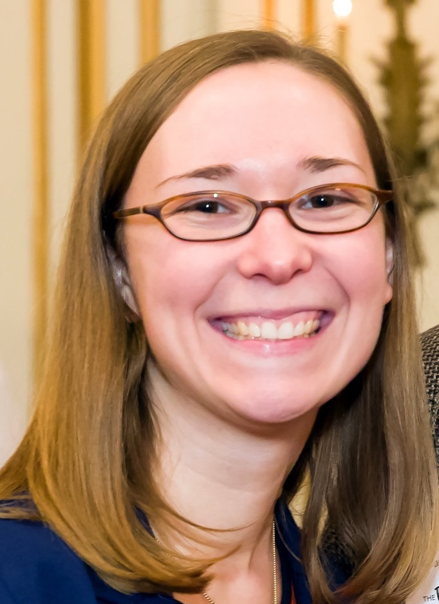
Introductions
ABOUT ME
JOB SEARCHING IS HARD. I MAKE IT LESS HARD.
Previously:
Career Program Manager at the Posse Foundation
Admissions officer at Brandeis University
History & East Asian Studies major at Harvard
Hello, world!
Julie Carroll, Outcomes Lead, Boston
julie.carroll@ga.co • www.linkedin.com/in/juliecarroll2
617-294-9022 • @JuliesTheBest
Notes:
Why I work at GA – I recently went through a job search.

Slide 5
Introductions
ABOUT YOU: SAY IT ON SLACK
Use the Outcomes channel
In <140 characters, share why you came to GA, and where you hope to go from here.
Example: “I was burnt out from years at the same accounting job. I want to learn to code and start a more exciting career as a developer.”

Slide 6
Introductions
ACTIVITY: COMMON GROUND
Please put your name plates away!
Find 1 person who has worked in the same industry as you.
Find 1 person who has faced a similar career challenge that you have faced (e.g. unemployment, career dissatisfaction, difficulty networking, etc.)
Find 1 person who shares your love for one of your favorite foods.
Remember everyone’s name and these answers!

Slide 7
What is outcomes?
GA OUTCOMES

Slide 8
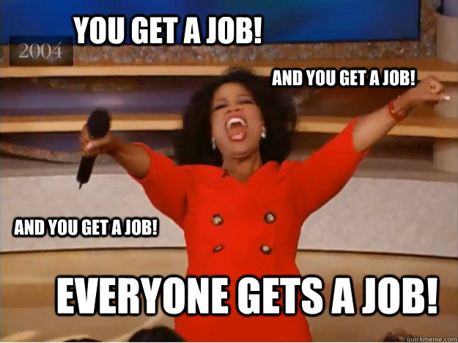
What is outcomes?

Slide 9
What is outcomes?
AM I GOING TO GET A JOB?
Five-finger check: How important is this question to you?
5 = super dee duper important

Slide 10
General Assembly Outcomes Benchmark
AM I going to Get a job?
99% of actively seeking GA immersive graduates achieve an outcome within 180 days of job searching
Boston’s track record is even higher
Five-finger check: How do you feel about GA’s Outcomes record?
5 = Fantastic and relaxed
1 = That’s nice but I’m definitely that 1%
Notes:
Definition of actively job seeking – you must want it – hustle, do the things we recommend. Types of people who do not fit this profile –
Graduate – you must graduate from the program
Web developer – you must want to be a web developer, not a technical PM, not a data scientist, not a project manager

Slide 11
General Assembly Outcomes Benchmark
AM I going to Get a job?
This is the first General Assembly bootcamp in Providence.
BUT we’ve done it online.
Notes:
Definition of actively job seeking – you must want it – hustle, do the things we recommend. Types of people who do not fit this profile –
Graduate – you must graduate from the program
Web developer – you must want to be a web developer, not a technical PM, not a data scientist, not a project manager

Slide 12
WHAT WE DO and WHAT WE DON’T DO
GA OUTCOMES

Slide 13




WHAT WE DO
Plus friendship!
Outcomes will make you more confident and capable in your job search.
You are in the driver’s seat.
…and some ass-kicking.

Slide 14
WHAT WE DO DO
What is “Outcomes Support”?
We check in with you.
We advise you.
We strategize with you.
We hold you accountable.

Slide 15
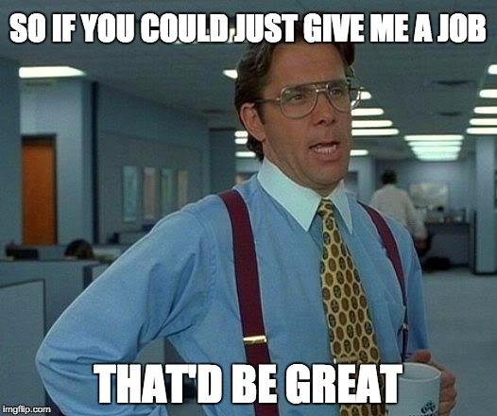
WHAT WE DON’T DO
We do not “get” you a job.
We do not take a hiring commission from companies that hire our grads.
We are not a job placement agency.

Slide 16
WHAT IS OUTCOMES
WHAT IS CONSIDERED AN OUTCOME?
An outcome is a paid opportunity as a web developer, including: a full-time job, internship, or a full-time contract lasting at least one month.
GA tracks outcomes for immersive graduates who are qualified, active job-seekers.
*GA currently supports immersive graduates only through their first outcome.*

Slide 17
ACTIVITY
WITH A LITTLE HELP FROM MY FRIENDS
Include your name with your responses
What are your career goals immediately following this course?
What challenges do you anticipate facing in achieving these goals?
What career-related expertise can you share with the group? (E.g. I’m a great resume editor.)
How can you support your colleagues during the job search?

Slide 18
OUTCOMES PROGRAMMING
GA OUTCOMES

Slide 19
OUTCOMES OVERVIEW
WHAT IS OUTCOMES?
In-Course*
Personal Branding
Digital Presence/LinkedIn
Networking
Catch-up Workshop
Resumes + Portfolios
Applying + Interviewing Strategies
Whiteboarding Practice
GA Profiles
What’s Next: Your Job Search
Post-Course*
Mock Interviews/Outcomes Day
Meet + Hire event
One-on-Ones and continued coaching
“Job Therapy” meetings
*If you have travel plans in the 3 weeks following graduation, let’s talk.

Slide 20
OUTCOMES programming
TOPIC
Deliverable
DIGITAL PRESENCE
LINKEDIN
NETWORKING
INFORMATIONAL INTERVIEWS
RESUMES + COVER LETTERS
New + Improved RESUME
PERSONAL BRANDING
ELEVATOR PITCH
The JOB SEARCH
JOB tracking System

Slide 21
Meet & Hire
GA OUTCOMES

Slide 22
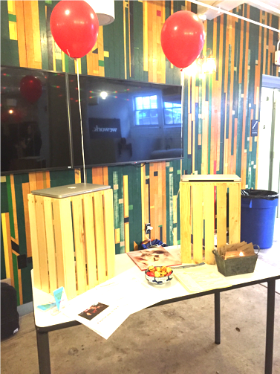
WHAT IS THE MEET & Hire?
Meet & HIRE
When: A few weeks after graduation
What: Reverse job fair
Who: You and your kick-ass projects + local employers

Slide 23
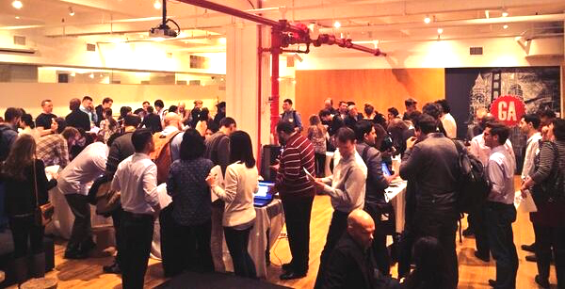
Meet & HIRE

Slide 24
Outcomes Expectations
GA OUTCOMES

Slide 25
Eligibility for Outcomes and M&H
Outcomes Expectations
You must graduate the GA program.
You must attend all Outcomes Programming both during and after the course.
You must complete all Outcomes assignments and surveys.
Why are we being such hard-asses? We want you to get a job! Pronto! #toughlove
Notes:
#TOUGH LOVE

Slide 26
OUTCOMES EXPECTATIONS
BECOMING A JOB SEEKER
In order to qualify for Outcomes support, you’ll need to complete the following AND begin your job search immediately after graduation (2 week cutoff).
resume
digital presence: LinkedIn &
GA PrOFILE
Online
portfolio
shareable way of tracking job search
(Trello)
participation in All Outcomes Programming
& Surveys

Slide 27
OUTCOMES EXPECTATIONS
REMAINING AN ACTIVE SEEKER
Job seekers must fulfill these requirements to receive continued Outcomes support. Job seekers must begin these responsibilities immediately after graduation (2 week cutoff).
10+ job applications/wk
networking (2+ events/month)
daily updating of job search tracker + responsiveness
continued study and application of skills
presence in preferred market
(Strongly encouraged)
*These are GA’s expectations globally. Boston’s expectations are higher.

Slide 28
OUTCOMES EXPECTATIONS
BECOME AN A+ JOB SEEKER
DO:
DON’T:
25-40 HOURS
2+ NETWORKING EVENTS
2-3 NETWORKING 1:1s
10+ TAILORED APPLICATIONS
SKILL BUILDING
WAIT TO BE PERFECT
PAUSE YOUR SEARCH
FOCUS ON 1 COMPANY
*TAKE MORE THAN 30 DAYS OFF*

Slide 29

OUTCOMES EXPECTATIONS
FAILURE TO MEET JOB-SEEKER EXPECTATIONS WILL RESULT IN EXCLUSION FROM OUTCOMES SUPPORT.

Slide 30
OUTCOMES EXPECTATIONS
TEAM CONTRACT
What can you expect from Julie?
What can Julie expect from you?
What can you expect from yourself?
What can you expect from your colleagues?
Notes:
Gallery Walk activity – notes around the room

Slide 31
Final Thoughts
GA OUTCOMES

Slide 32
ReLAx. WE’re in this together.
Final ThougHts
#friendship

Slide 33
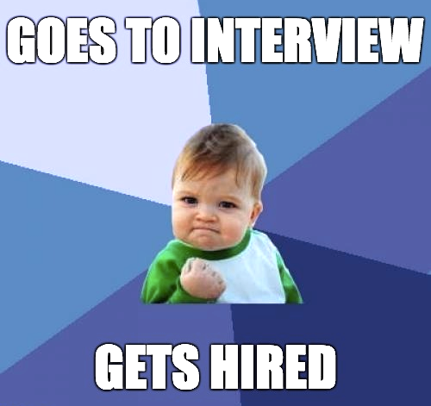
NEXT STEPS…
Final ThougHts
Outcomes slide deck repository
Assignment: In the Google spreadsheet that Julie shared with you, write down:
What is your Outcomes goal when you complete this course?
What challenges will you face achieving that goal?
Assignments in Google doc due before next Outcomes workshop.

Slide 34
Q&A
GA OUTCOMES
Exit ticket: https://ga-research.typeform.com/to/SXA5M7

